Slide 1
SECURE DATA HIDING IN IMAGES USING STEGANOGRAPHY
CAPSTONE PROJECT
Presented By: Pragya Bhardwaj
Student Name : Pragya Bhardwaj
College Name & Department : Banasthali Vidyapith (B.TECH. CSE)

Slide 2
OUTLINE
Problem Statement
Technology used
Wow factor
End users
Result
Conclusion
Git-hub Link
Future scope

Slide 3
Problem Statement
In today's digital world, secure communication is essential. While encryption can be intercepted, steganography hides messages inside images for extra security. This project uses Python and OpenCV to encode and decode hidden messages in images.

Slide 4
Technology used
LIBRARIES: CV2
OS
STRING
PLATFORM: Python 3.11.9

Slide 5
Wow factors
1. Steganography - Hiding Messages in Images
Instead of traditional encryption (text-to-text), this method hides the message within an image's pixel values.
This makes it nearly invisible to anyone inspecting the image with the naked eye.
2. Minimal Image Distortion
The message is stored within pixel color values (RGB), ensuring the image looks normal.
Unlike watermarking or QR codes, there is no visible clue that a secret message is inside.
3.Potential Real-World Applications
Cybersecurity & Data Privacy: Secret communication without drawing attention.
Digital Watermarking: Protects intellectual property by embedding invisible messages.
Secure File Transfers: Send hidden data disguised as ordinary images over insecure channels.

Slide 6
End users
Cybersecurity Enthusiasts & Ethical Hackers
Journalists & Whistleblowers
Digital Content Creators & Watermarking Services

Slide 7
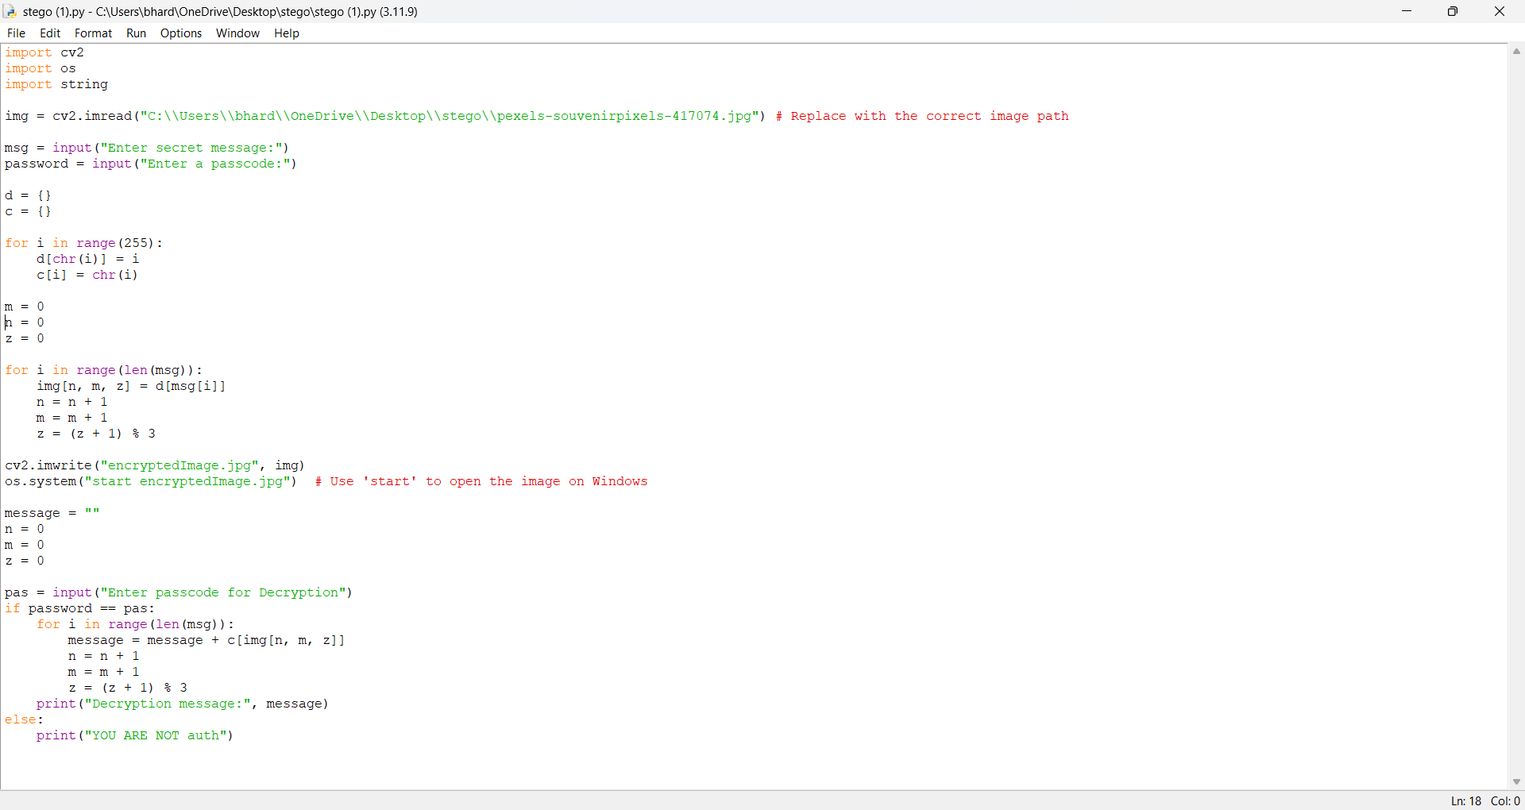

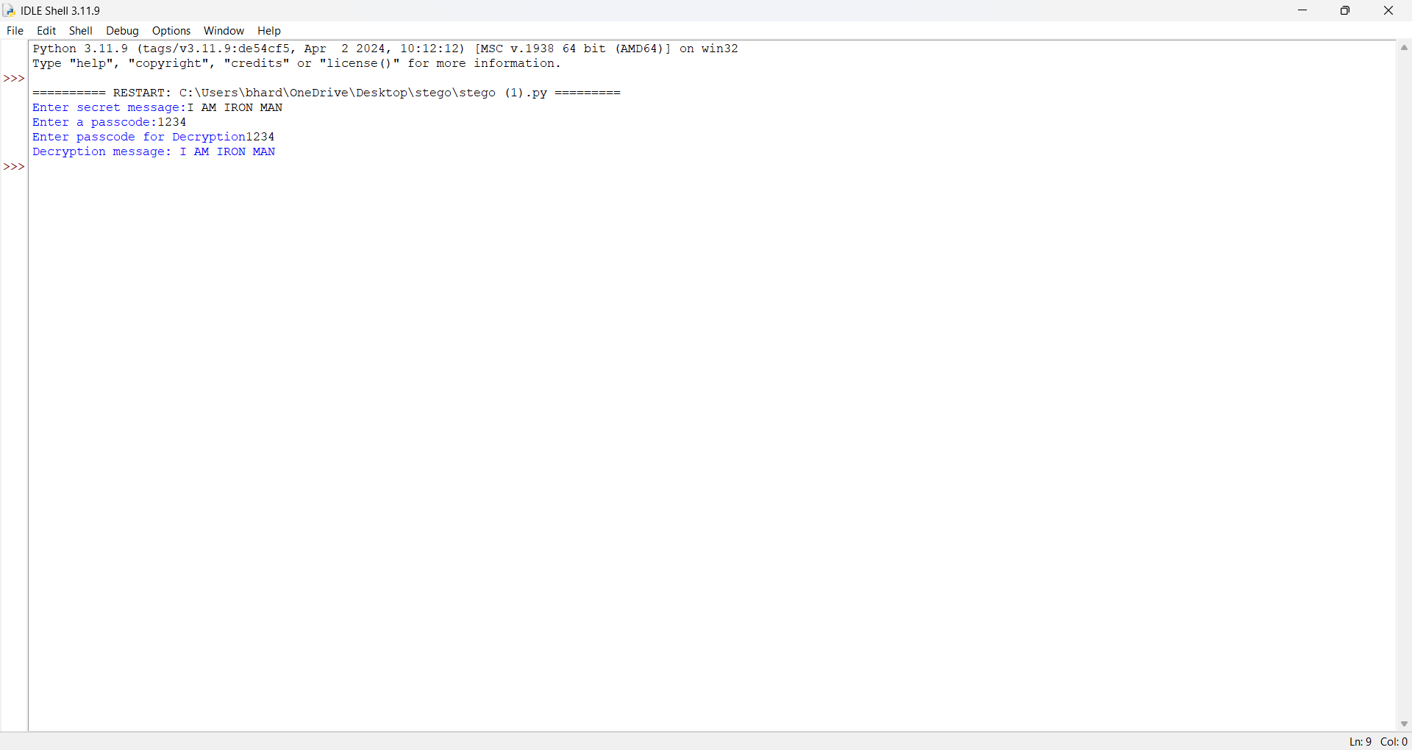
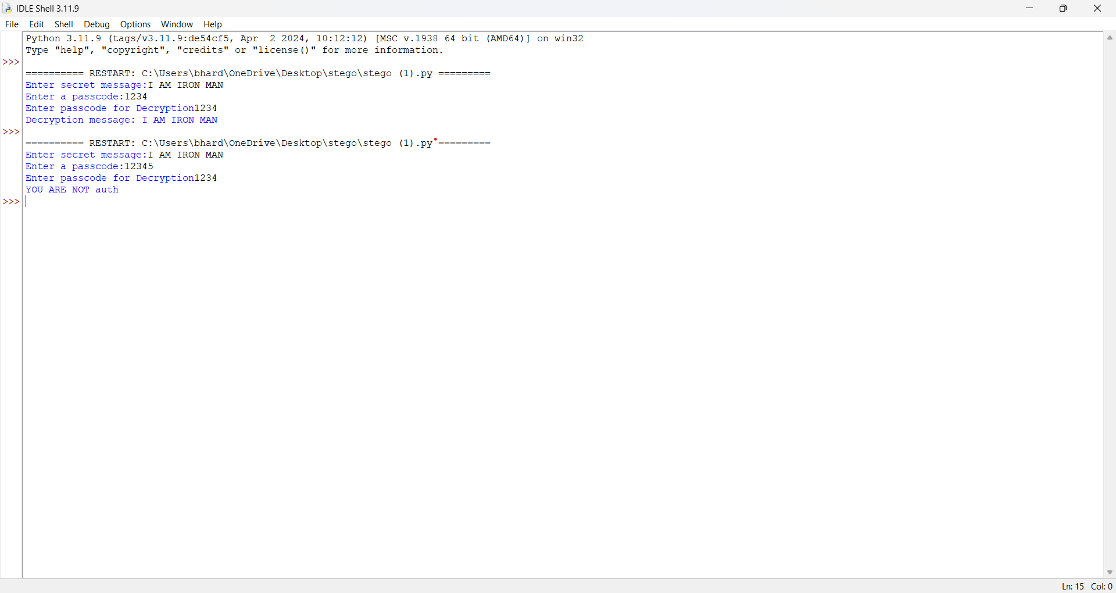
Results

Slide 8
Conclusion
This project successfully implements image-based encryption by storing messages in pixel values. With password-protected decryption, it ensures security and confidentiality of sensitive data

Slide 9
GitHub Link
https://github.com/Pragya-Bhardwaj/IBM-SKILLSBUILD.git

Slide 10
Future scope(optional)
Mobile & Web app integration for wider accessibility.
Enhancing security using Least Significant Bit (LSB) Steganography.

Slide 11
THANK YOU

